Slide 1
WICCI COUNCIL (PARUL JAIN)
WOMEN´S INDIAN CHAMBER OF COMMERCE AND INDUSTRY
www.wicci.in

Slide 2
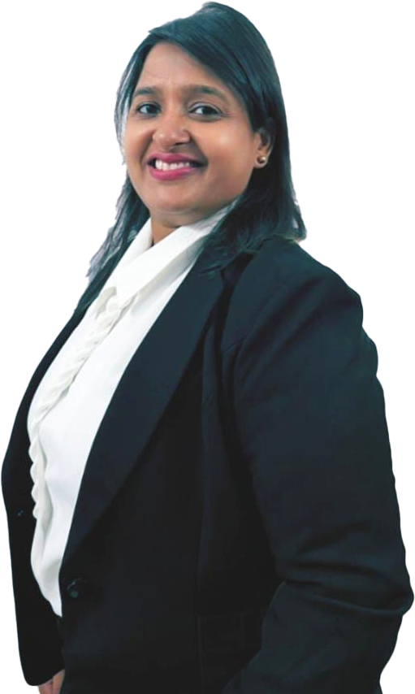
Welcoming
Council Member to
WICCI
President, Vice President
and 20+ Nominated Council Members

Slide 3
Council Vision &Mission
She is a criminal lawyer practice in District court and high court in Delhi
she feels the beauty of the world while traveling and explore culture various parts of the world suddenly idea come to in my mind after covid I quit my advocacy and stars travel company and the name of company is pro plus holidays.
Help in tourism to explore the world. Travel to exotic destinations around the corner.
“We also arrange travel options for women who love to explore locations”.

Slide 4
PARUL JAIN(PRESIDENT)
Parul graduated from CCS university, Meerut in 2015 in Legum Baccalaureus. Her qualifications are BA, MA in English, LLB. She took part in various Moot Court Competition. She did lots of work for the welfare of society and attended various Seminars and Events with Ambassadors for the encouragement of Women in the Society. Her Hobbies are Reading, Social work, Travelling. She prepared for judiciary examination. She has done her Internships under Jitendra Kumar and Gajraj Singh and dealt Criminal Cases related with Murder and POCSO. She had her law firm in Tis Hazari Court for last 4 years. Presently, She is Owner of her Travel Company in the name of PRO PLUS HOLIDAYS PVT LTD.

Slide 5
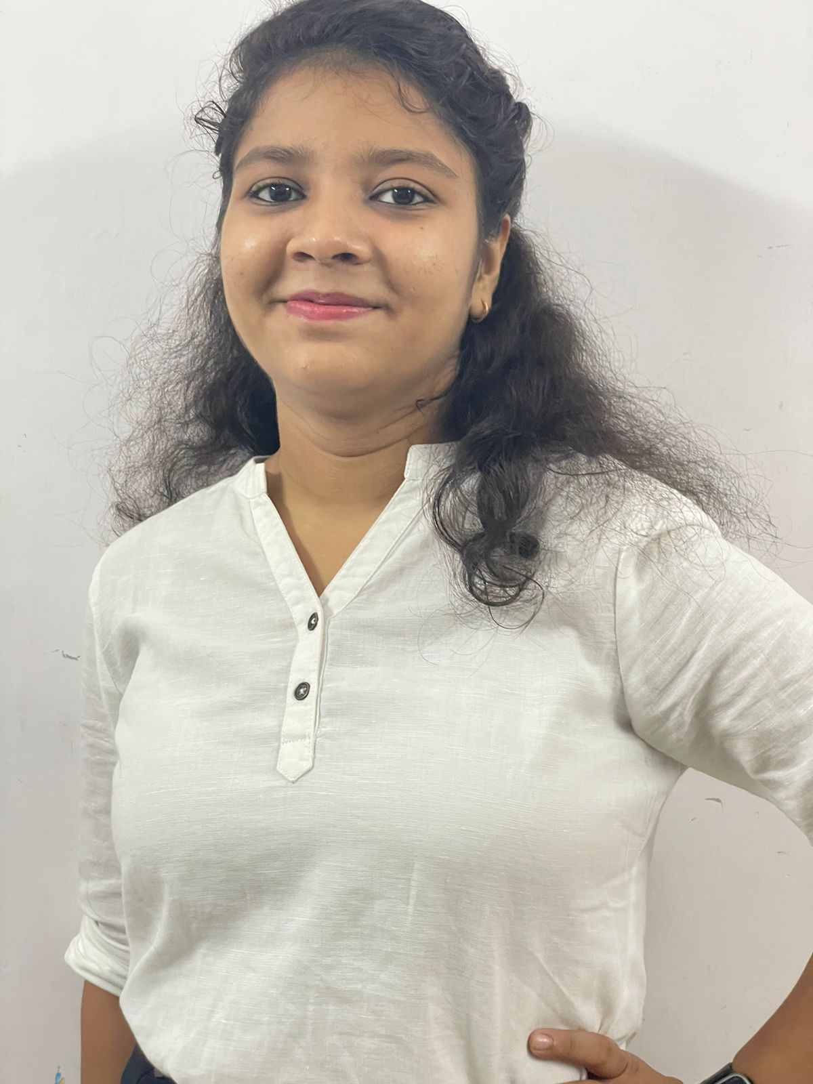
HARSHITA (VICE PRESIDENT)
Harshita is 20 years old girl. She is full of love and joy and at same time an altruistic person and love to travel mainly Hiking and Nature Walk. She has done her schooling from Government Sarvodya Kanya Vidyalaya. Recently she is learning Basic Computer and English Speaking. She is doing her graduation from Delhi University. She works in PRO PLUS Holidays pvt.ltd.

Slide 6
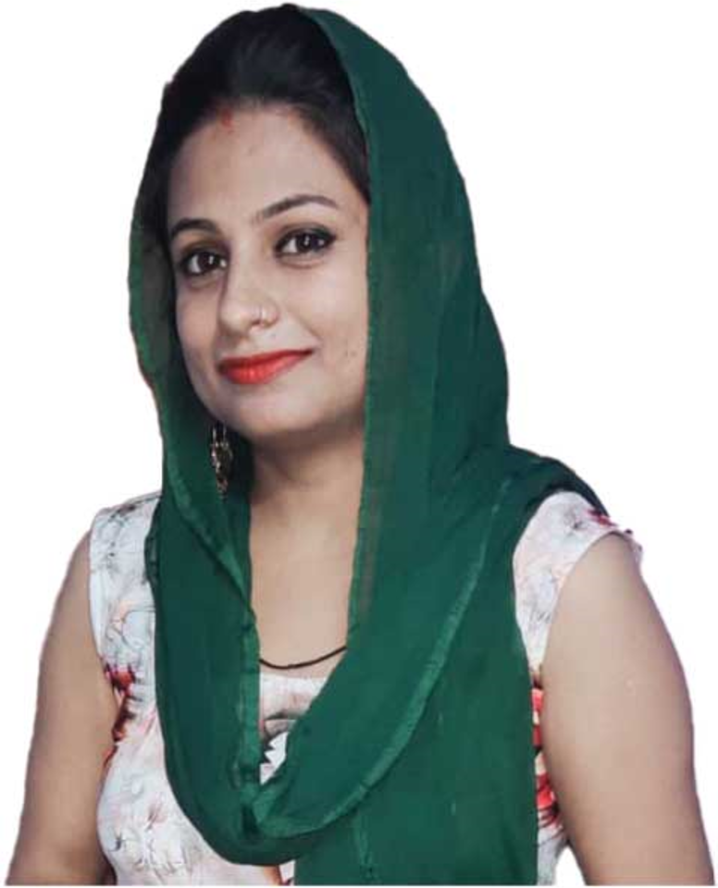
SHALU DHIMAN (COUNCIL MEMBER)
Shalu Dhiman graduated from PU university in 2014 in Chandigarh . She is active participant in Social and Religious activities. She has prepared for M.A Examination and recents. Currently she is active for social activity.She has pass B.A in 2014 in PU University

Slide 7
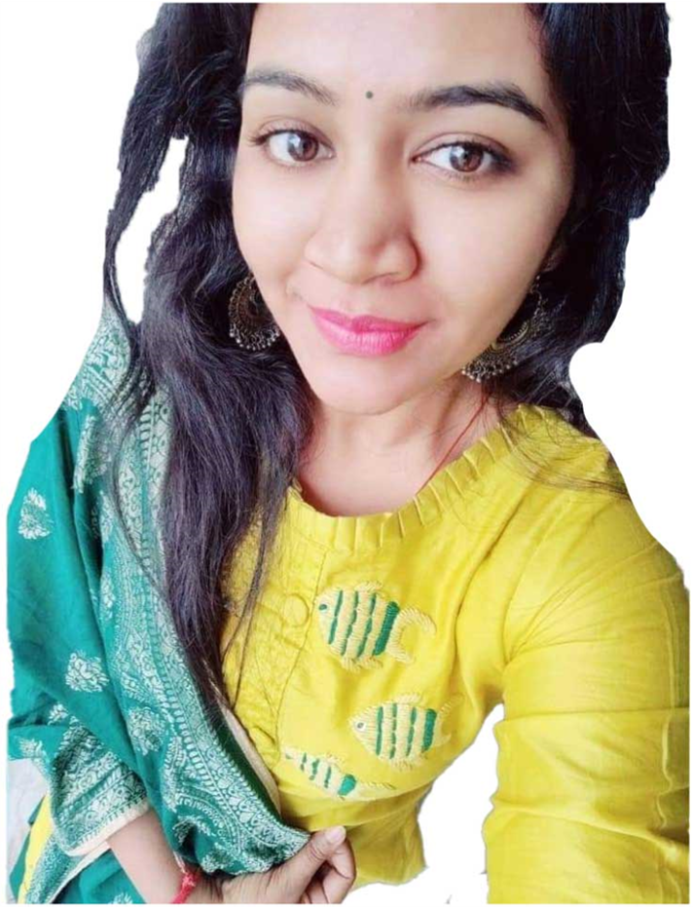
HEMA JAIN (COUNCIL MEMBER)
HEMA JAIN graduated from KUK university in 2009 in SONIPAT She took part in various social Competitions at Inter and Intra state level and achieved. She has done paper representation on Company Law Act, 2013. She has Practiced in Taxation Industry In Rai sonipat She is active participant in Social and Religious activities. She has prepared for Social Services and recently she is practicing In taxation law.

Slide 8
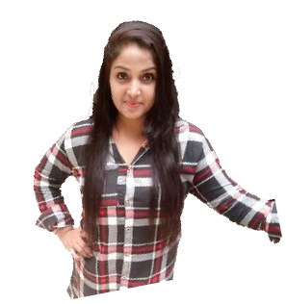
CHAWI BHARDWAJ (COUNCIL MEMBER)
Chavi Bhardwaj graduated from MJP Rohilkhand university in Bareli in 2019 in Bijnore She took part in various social Competitions at Inter and Intra state level and achieved. She has done paper representation on as an advocate She has Practiced in judicial preparation In Ghaziabad Uttar Pradesh She is active participant in Social and Religious activities. She has prepared for Social Services.

Slide 9
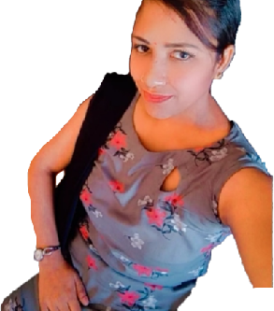
DEEPA GARG (COUNCIL MEMBER)
Deepa Garg graduated from KUK university in 2014 in Panipat She took part in various social Competitions at Inter and Intra state level and achieved. She has deals in teaching line . She is active participant in Social and Religious activities. She has prepared for Master Degree Examination and recently she is teaching in Higher secondary schools.

Slide 10
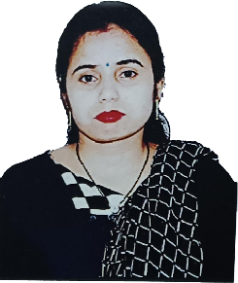
POOJA (COUNCIL MEMBER)
Pooja graduated from KUK university in 2016 in Panipat She took part in various social activity and achieved. She has done paper representation on social women's . She is active participant in Social and Religious activities. and recently she is practicing in Social services.

Slide 11
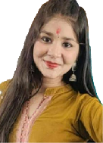
GAZAL (COUNCIL MEMBER)
Gazal, age 18 years, has completed her schooling from Government Sarvodaya Kanya Vidyalaya. Her hobbies are dancing, writing and cooking. Recently she is preparing for competitive exams and giving home tutions. She also engaged in basic travel and tourism course

Slide 12
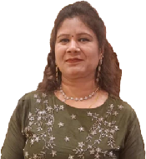
SHALU(COUNCIL MEMBER)
Shalu, 39 years old, done her schooling from Jain school, Haryana. She is interested in serving society at large. She is an altruistic women with clear objectives in her life. Right now she is working on Grocery Shop.

Slide 13
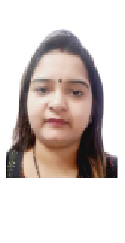
NEETU GOYAL (COUNCIL MEMBER)
Neetu Goyal is fashion designer. She is quiet fashionable, stylish nd altruistic person. She is having interest in overall development of the society by improving their dressing sense. She loves travelling and learning new things. She is very charming by her nature.

Slide 14
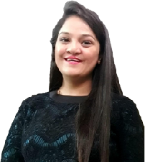
LATA AGGARWAL (COUNCIL MEMBER)
Name : Lata Aggarwal
Founder @craftscorner by lata
We deal in all kinds of handmade, homemade, and corporate gifts.

Slide 15
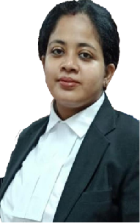
PALLAVI (COUNCIL MEMBER)
Pallavi graduated from MD university in 2014 in Legum Baccalaureus. She took part in various Moot Court Competitions at Inter and Intra state level and achieved 1st rank in inter moot court competition. She has done paper representation on Company Law Act, 2013. She has done her Internship under Adv G.K Buddhiraja. She is active participant in Social and Religious activities. She has prepared for Judiciary Examination and recently written Delhi Judiciary Mains 2018-2019. Currently she is practicing law in Patiala House Court near Pragati Maidan.

Slide 16
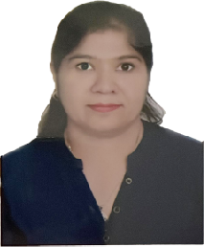
SANIKA(COUNCIL MEMBER)
Sarika, age 40, plays an important role in servicing society. She provide tuitions to children. She is active in working with various NGOs. Her aim is to help others by solving their problems as much as possible. She loves cooking and travelling. She also served society at time of covid crisis.

Slide 17
SUPPORTED BY
WICCI is supported by the massive global networks of ALL Ladies League (ALL), Women Economic Forum (WEF), and SHEconomy.
ALL is a movement of ‘Sisters Beyond Borders.’
WEF is a platform for ‘Business Beyond Borders.’ SHEconomy is e-commerce for women worldwide in Goods & Services for ‘Commerce Beyond Borders’

Slide 18
COUNTRIES REPRESENTED
Albania, Angola, Armenia, Argentina, Australia, Azerbaijan, Bangladesh, Brazil, Burundi, Cameroon, Canada, Chad, China, Costa Rica, Croatia, Cyprus, Czech Republic, Colombia, Ecuador, Egypt, Ghana, Germany, Greece, Guatemala, Hong Kong, Hungary, India, Italy, Israel, Ireland, Japan, Kazakhstan, Kenya, Kyrgyzstan, Lesotho, Luxembourg, Malawi, Malaysia, Mexico, Moldova, Monaco, Montenegro, Morocco, Mozambique, Malta, Netherlands, Nigeria, Nepal, New Zealand, North Macedonia, Norway, Paraguay, Portugal, Peru, Puerto Rico, Philippines, Qatar, Romania, Russia, Rwanda, Serbia, Singapore, Slovenia, Spain, South Africa, South Korea, Suriname, Sweden, Switzerland, Syria, Tunisia, Turkey, Uganda, Ukraine, UK, Uruguay, Venezuela, Vietnam, Virgin Islands (US), UAE, USA, Uzbekistan, Zimbabwe.

Slide 19
WOMEN'S INDIAN CHAMBER OF COMMERCE ANDINDUSTRY

